Slide 1
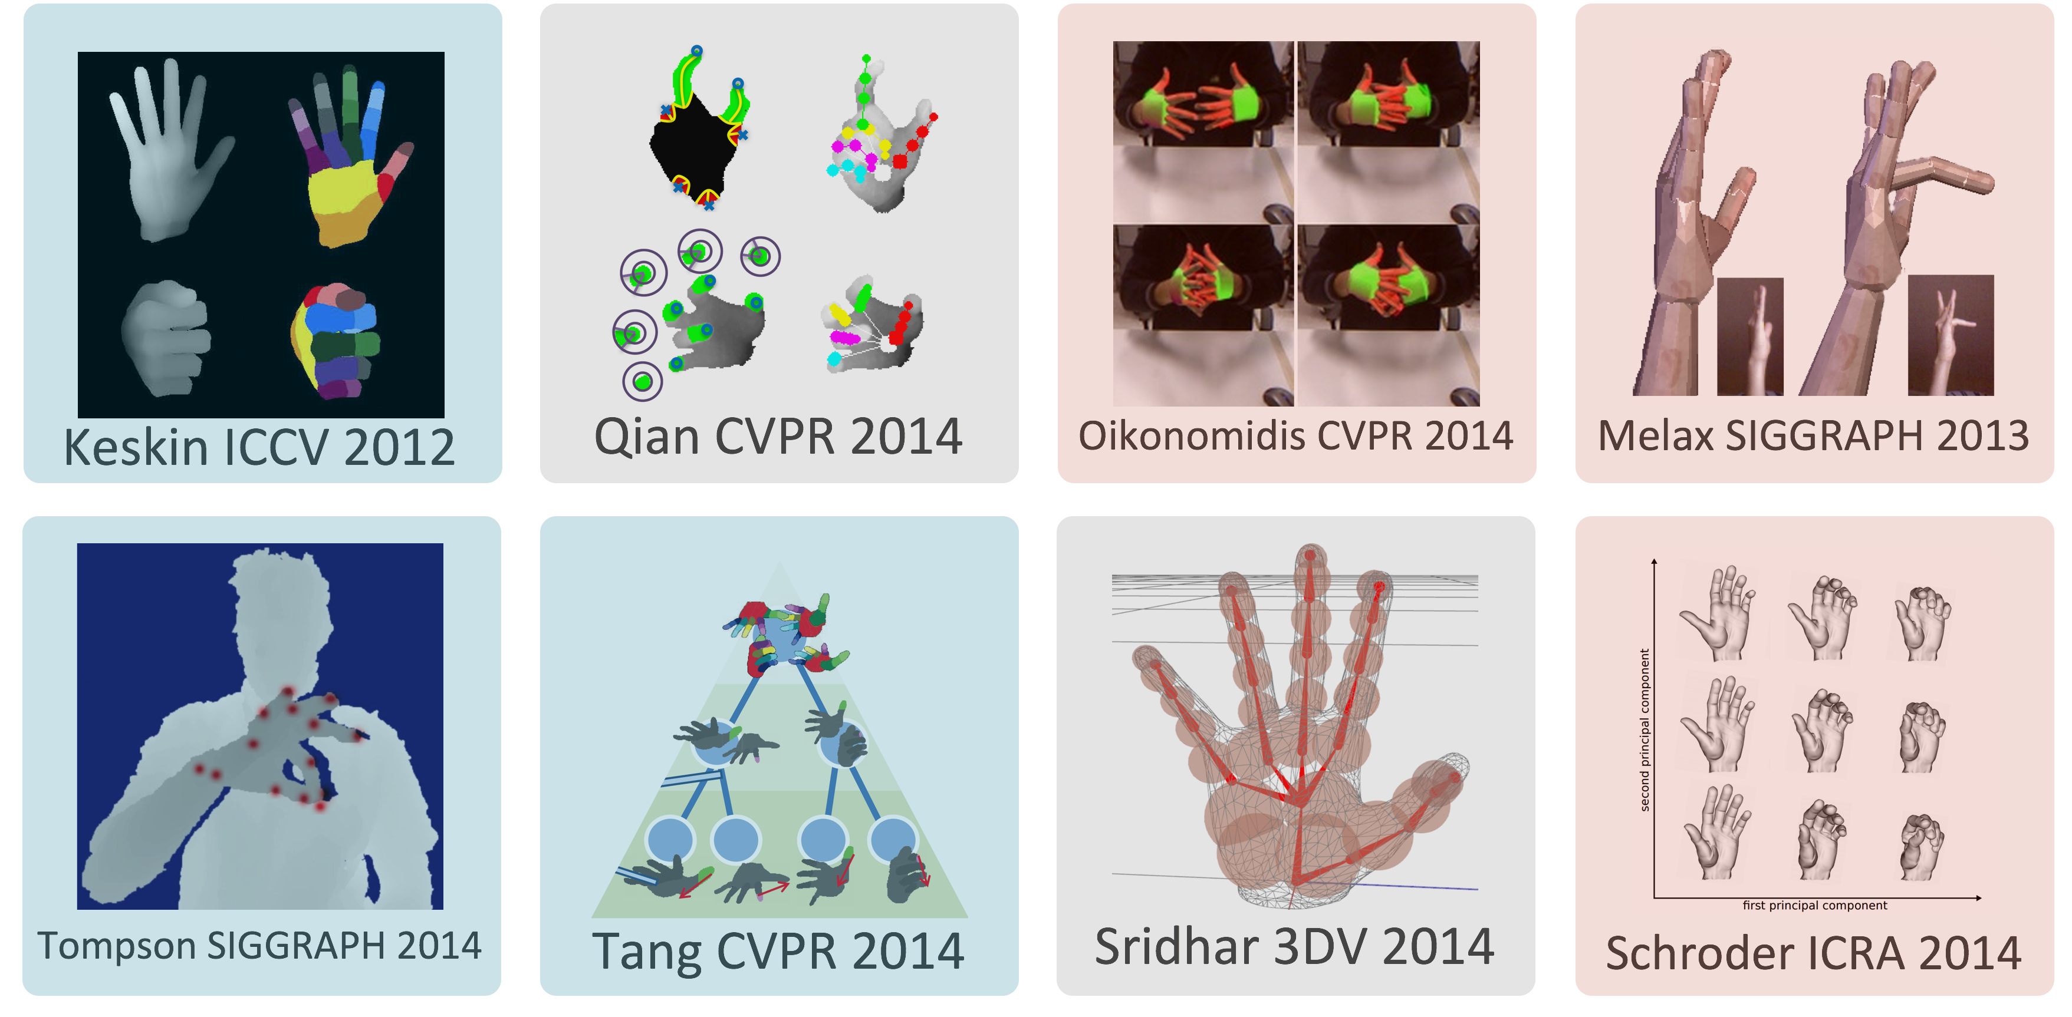

Slide 2


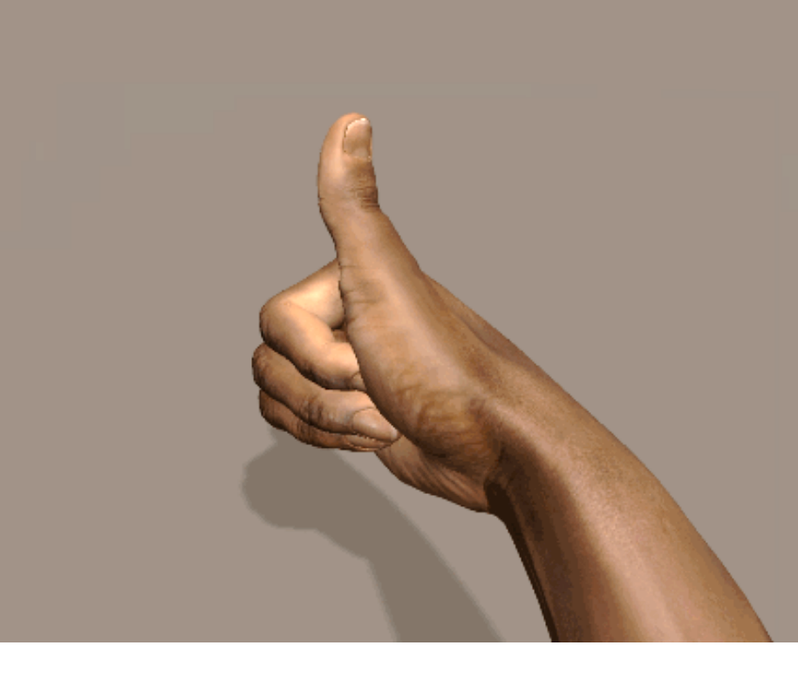
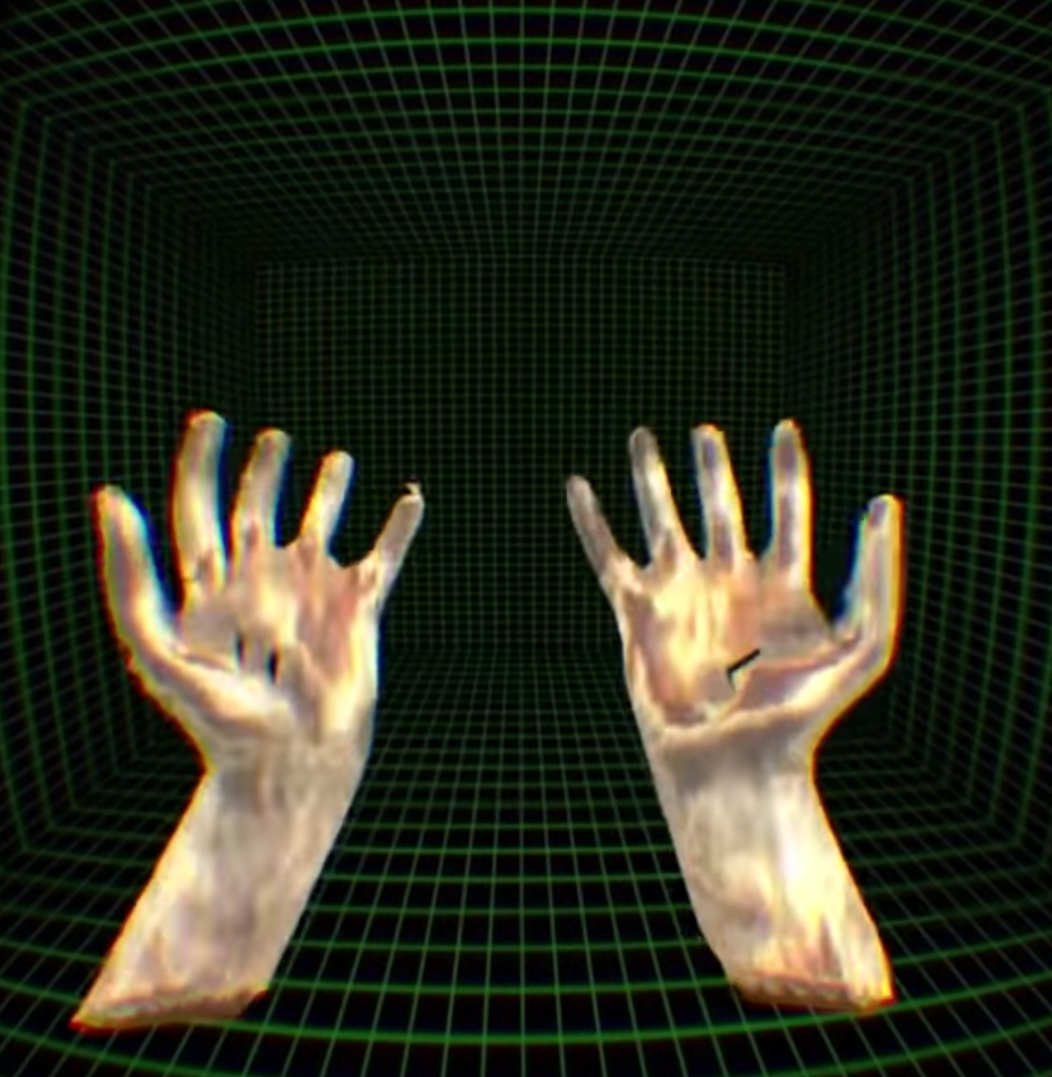
“Bring your own hands to virtual reality”

Slide 3
Generic pipeline
Hand data
RGBD frame
Modeling
Tracking
Skinning
Hand shape
Hand pose
(High-res) template mesh

Slide 4
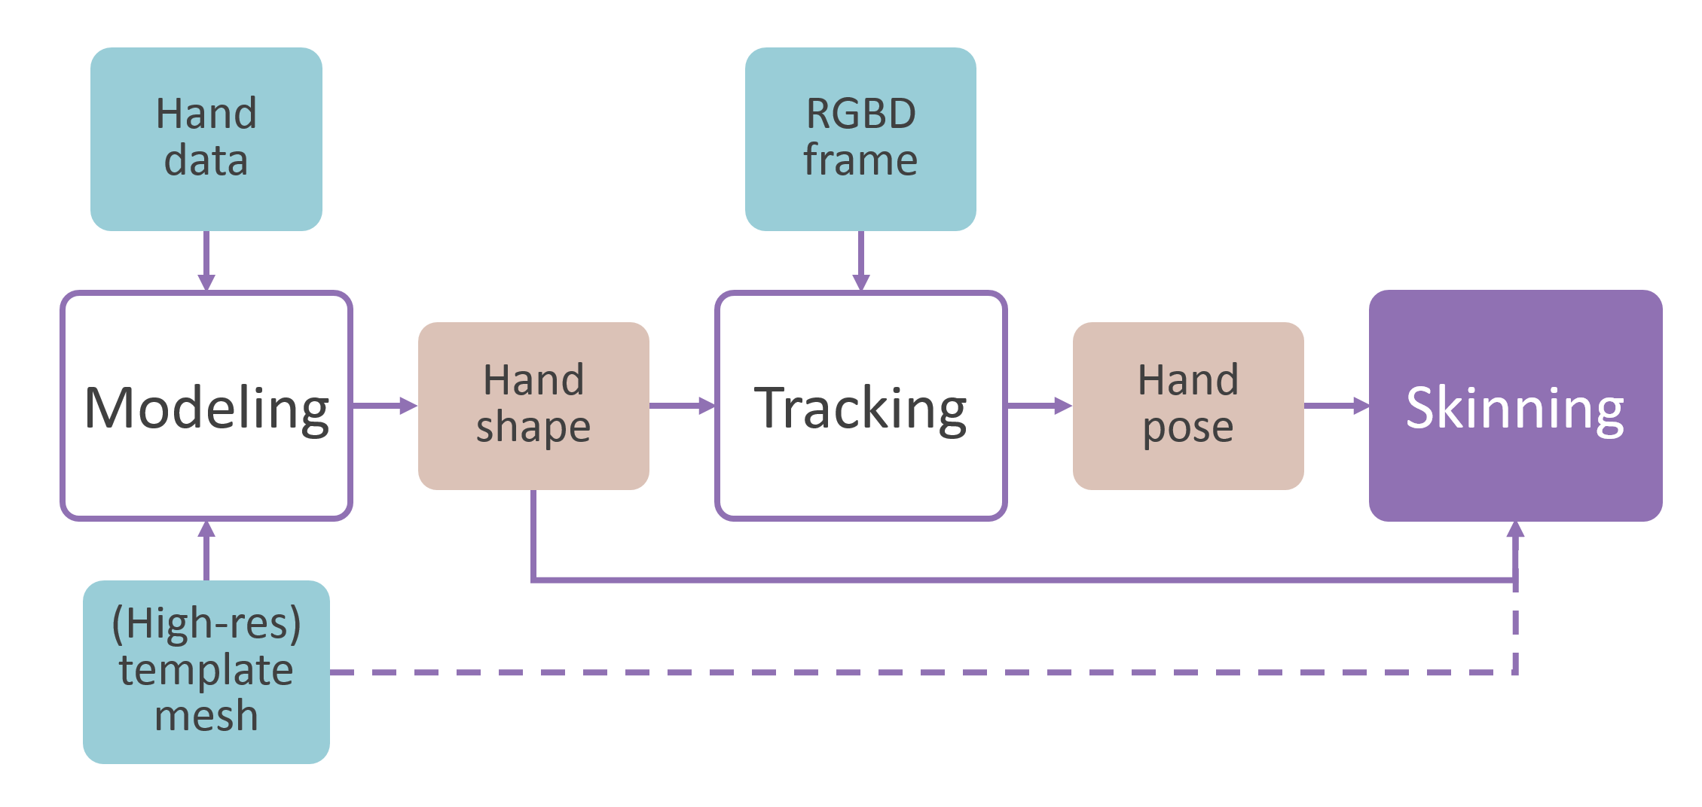
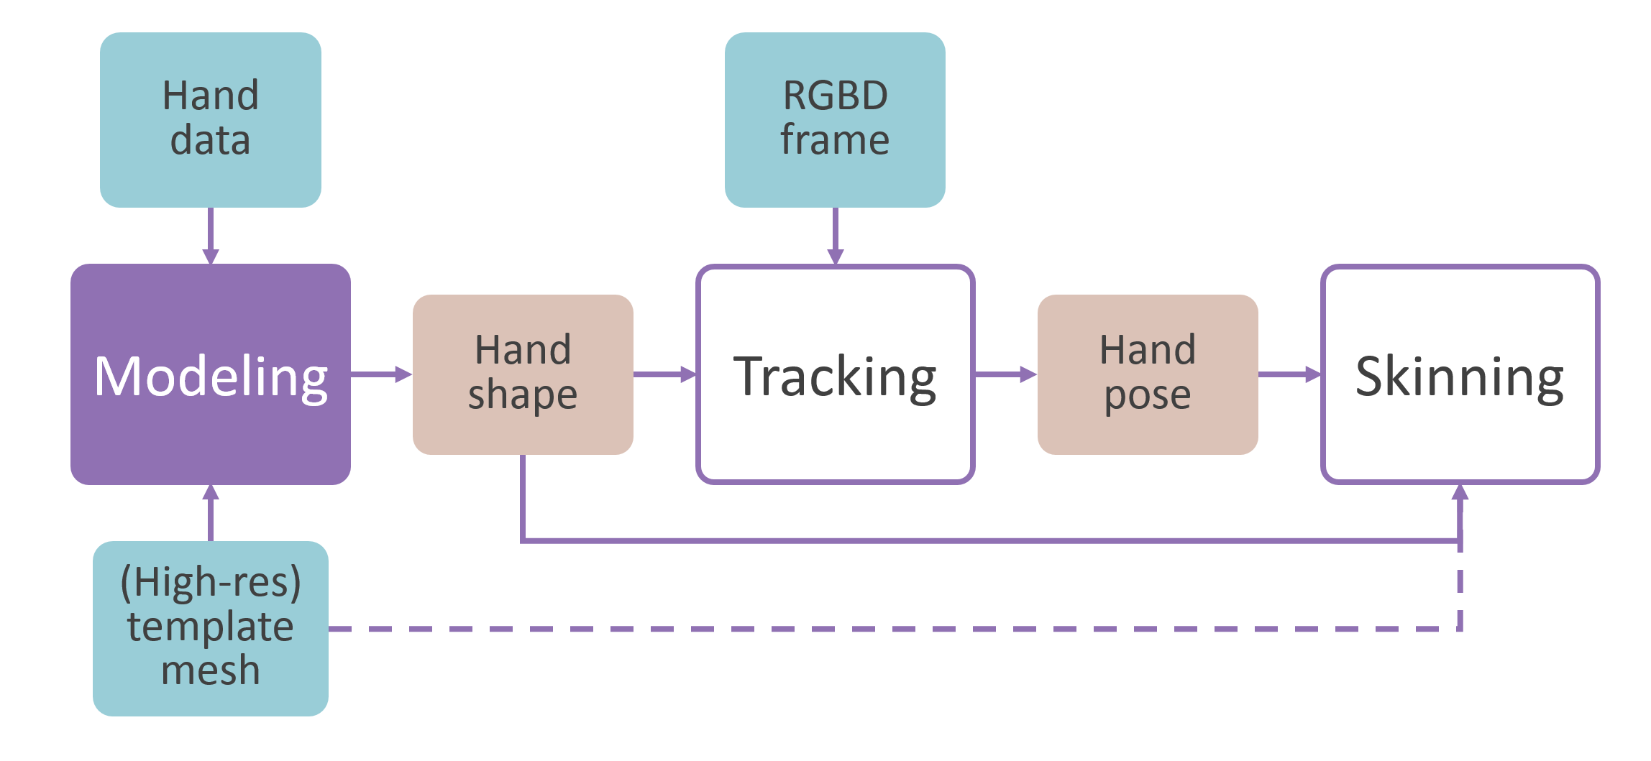
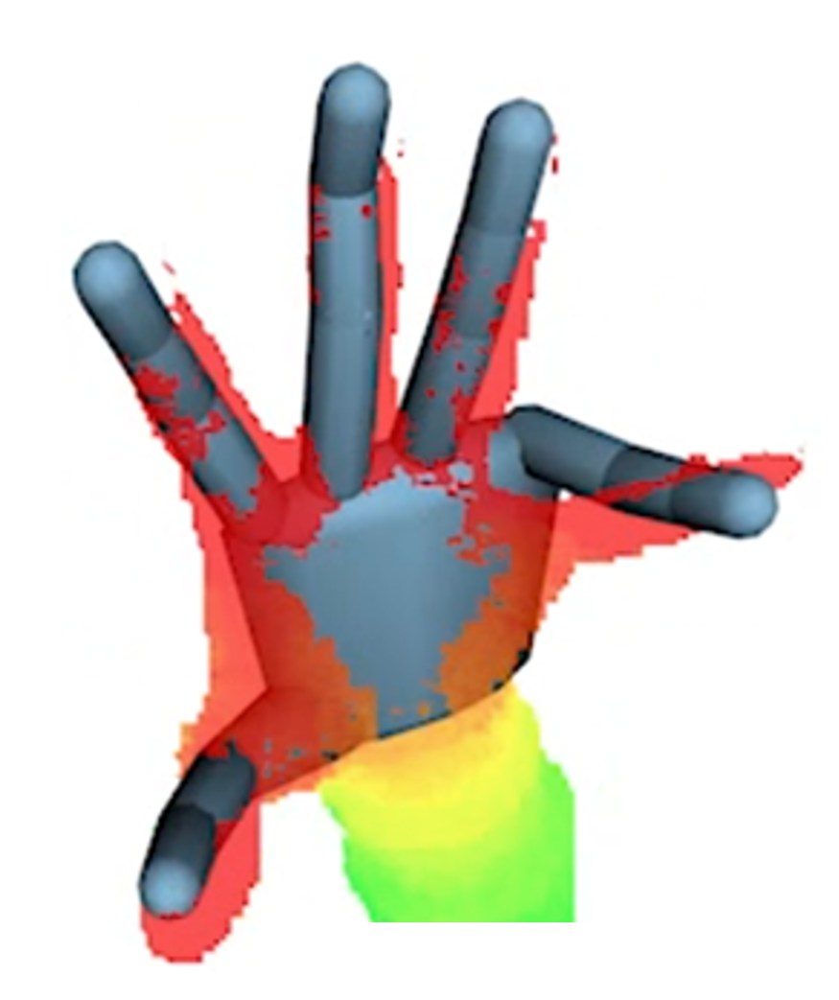
Why customizing the hand model?

Slide 5
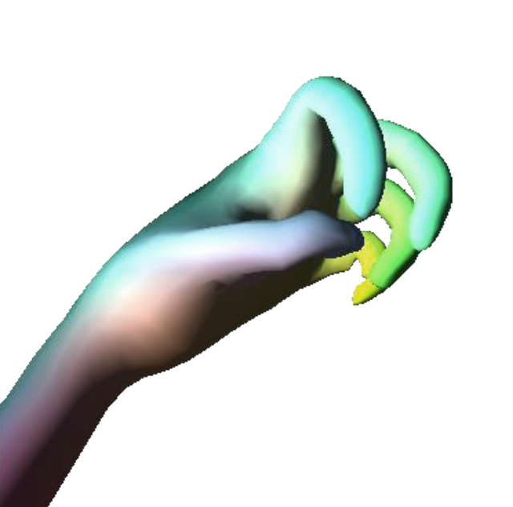
Why realistically animating the hand model?

Slide 6
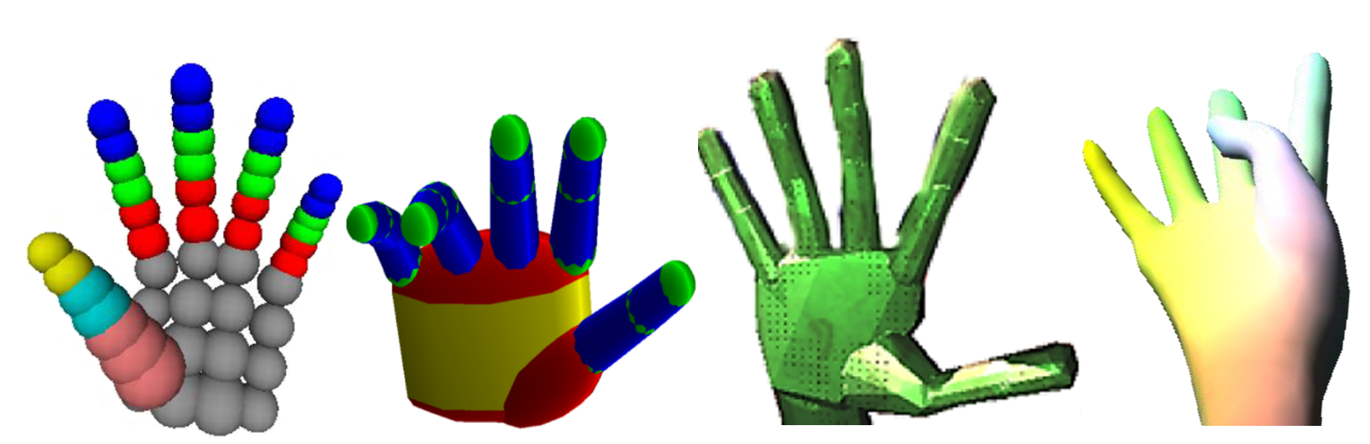
Alternative hand model representations

Slide 7
Convolution surfaces

Slide 8
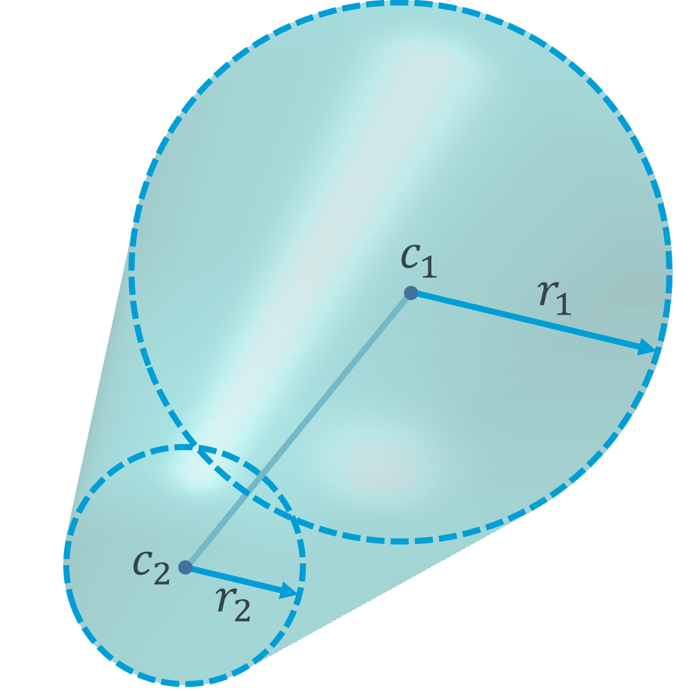
Convolution surfaces

Slide 9
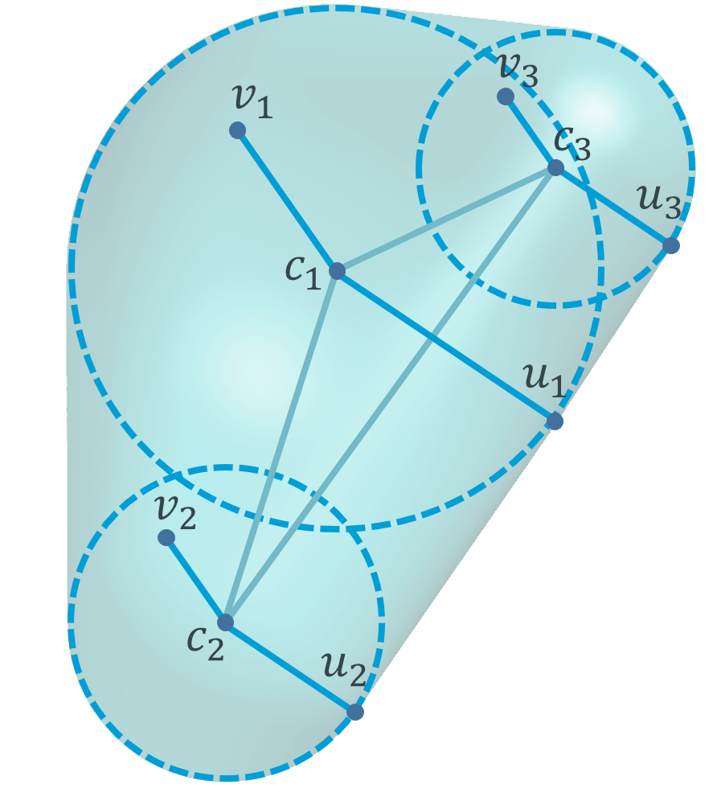
Convolution surfaces

Slide 10
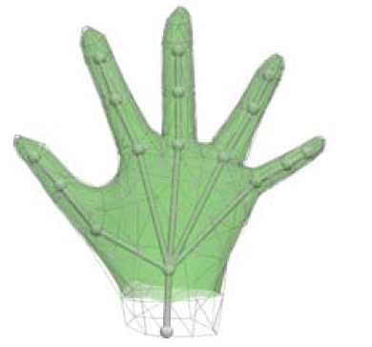
Triangular mesh with embedded skeleton (Taylor et. al.)
Hand data
RGBD frame
Modeling
Tracking
Skinning
Vertices and bones positions
Vertices and bones positions
(High-res) template mesh

Slide 11
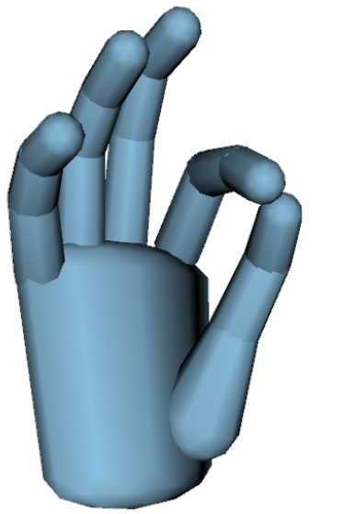
Spheres/Cylinders model (Tagliasacchi et. al.)
Hand data
RGBD frame
Modeling
Tracking
Skinning
Cylinders size and transformations
Cylinders transformations
(High-res) template mesh

Slide 12
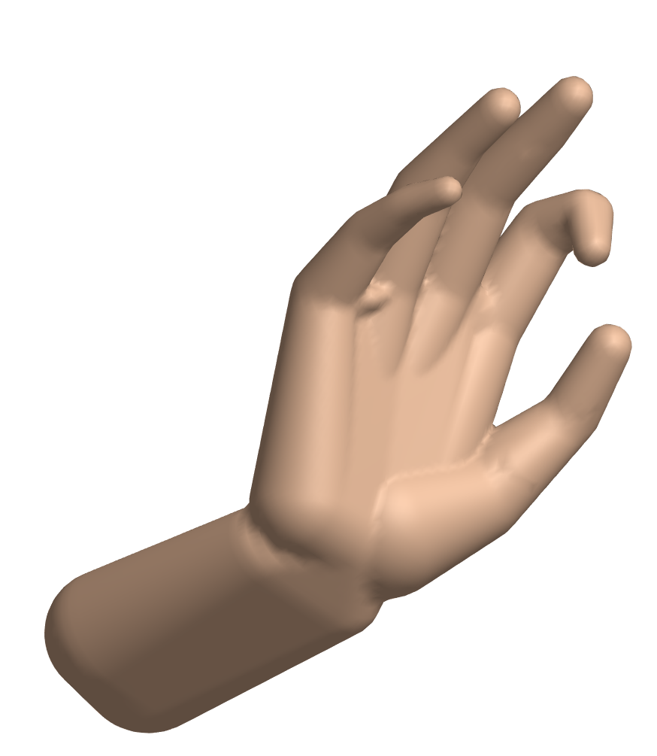
Convolution Surfaces model
Hand data
RGBD frame
Modeling
Tracking
Skinning
Control points positions and radii
Control points positions
(High-res) template mesh

Slide 13
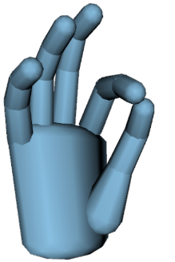

Hand modeling
Low precision with small number of building blocks
High precision, but does not model articulated rigid object
Higher precision for the same number of building blocks

Slide 14
Hand tracking
Closest point query in closed form for each rigid segment
Closest point query in linear time in number of triangles. Without additional regularization, rigid parts of the hand model can deform to fit the data and the individual vertices can shift to fit the sensor noise.
Closest point query in closed form for each rigid segment

Slide 15
Hand skinning
Requires retargeting to template mesh
Requires field function construction
Ready to use for implicit skinning

Slide 16
Modeling

Slide 17
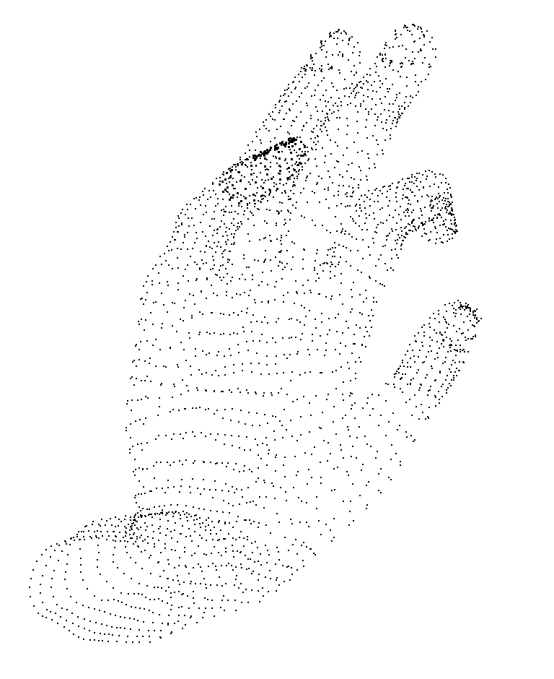
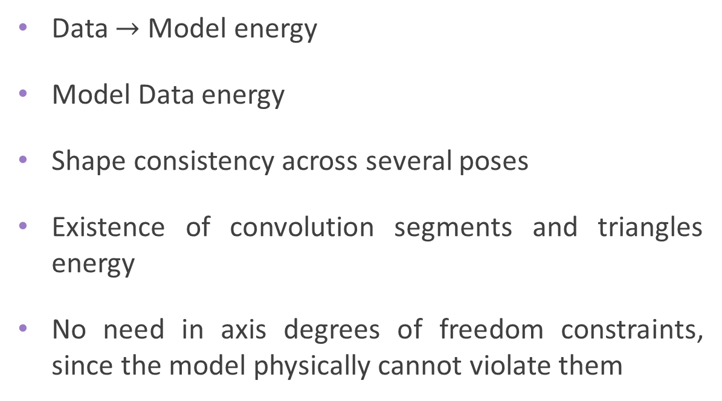
Modeling
Data $→$ Model energy
Model Data energy
Shape consistency across several poses
Existence of convolution segments and triangles energy
No need in axis degrees of freedom constraints, since the model physically cannot violate them

Slide 18
9
5
13
1
10
6
14
2
7
17
11
15
3
29
30
18
28
8
12
16
4
19
23
22
20
24
25
26
27

Slide 19
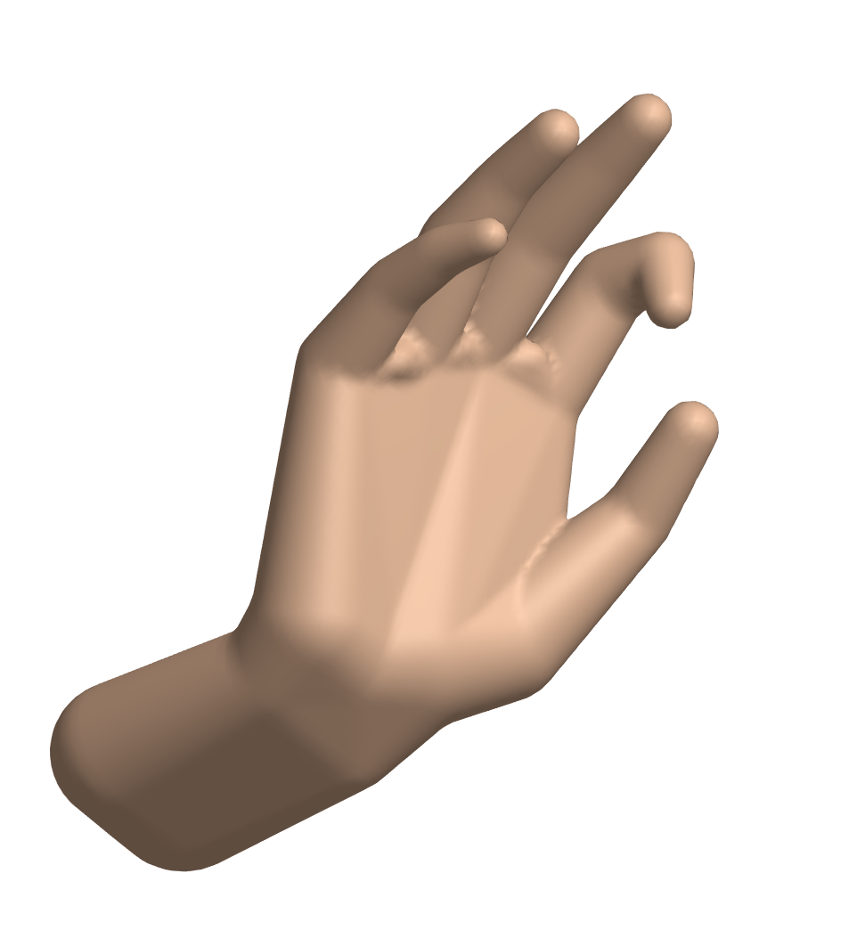
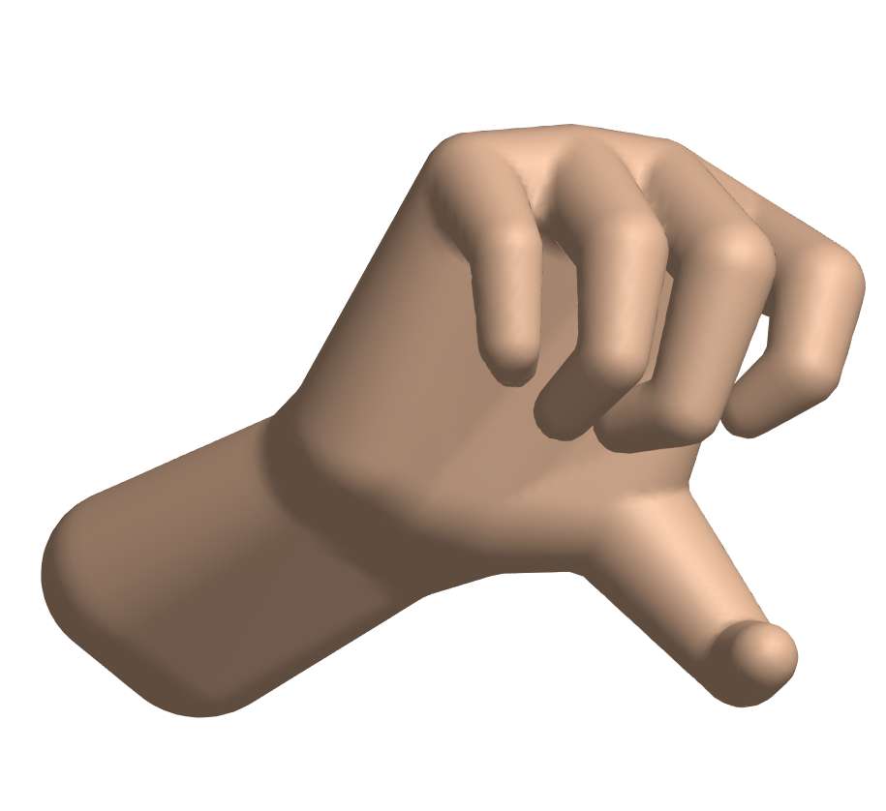
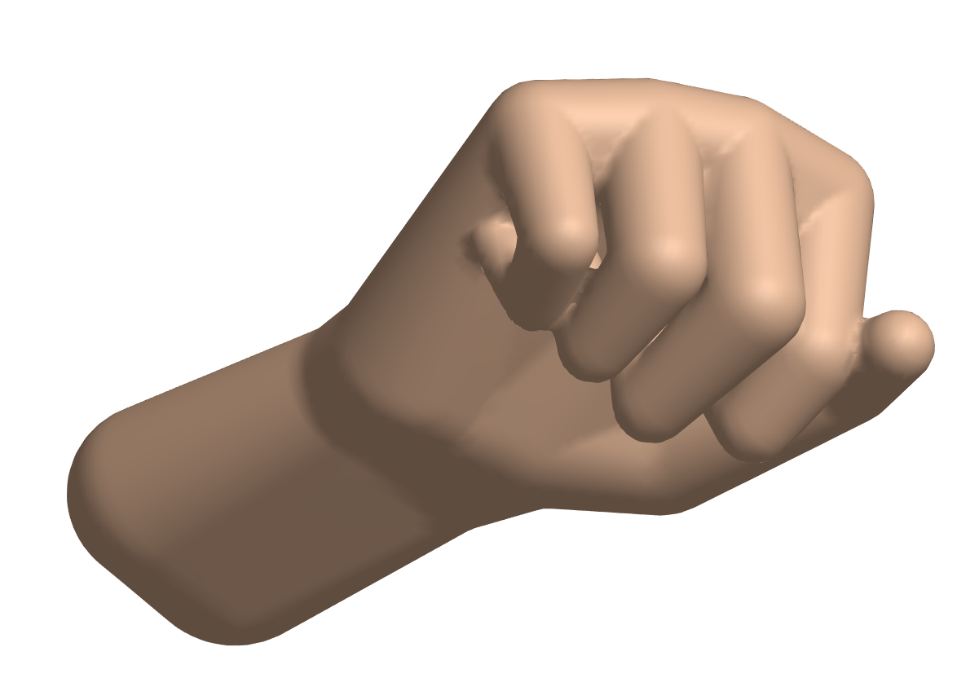
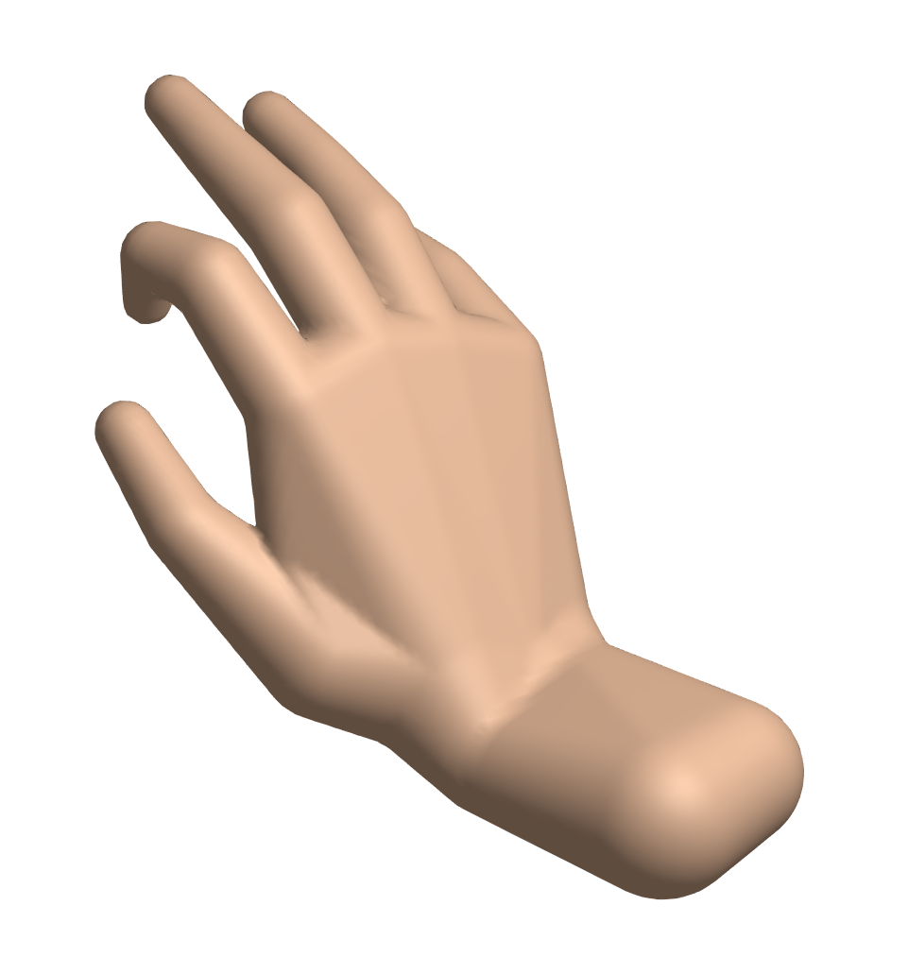
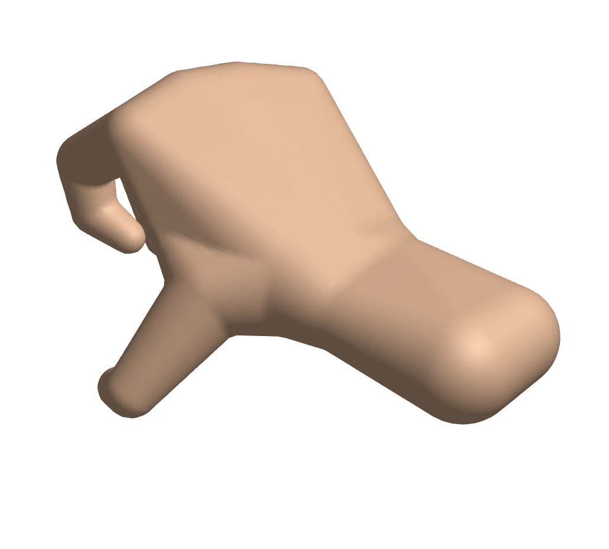
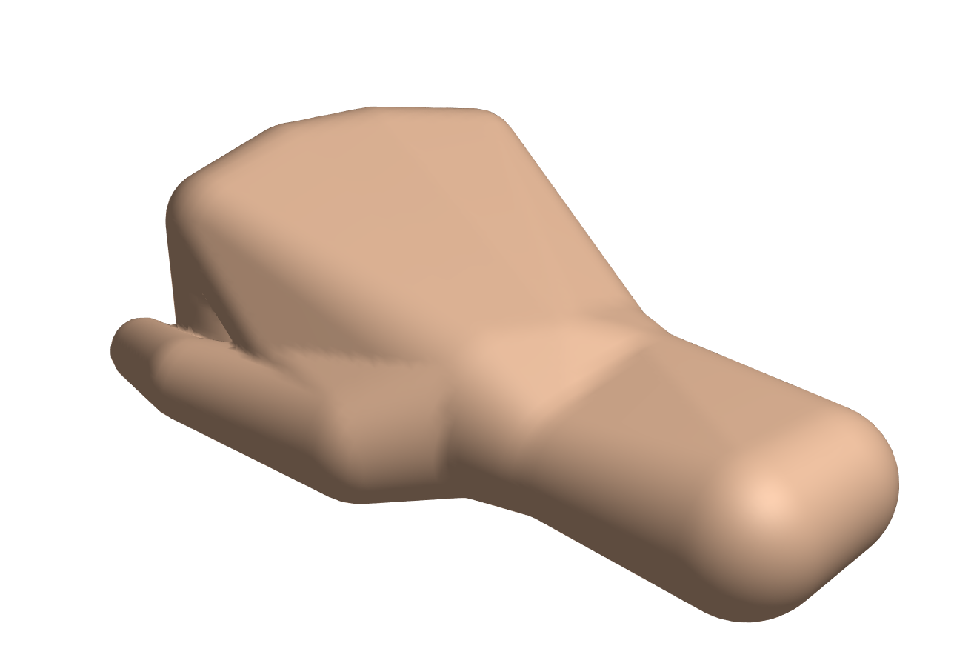

Slide 20
15
8
22
17
18
1
10
11
24
25
3
4
12
13
19
20
29
26
27
5
6
37
38
36
31
32
40
21
41
28
14
39
7
33
34
49
43
44
35
42
45
46
47
48

Slide 21
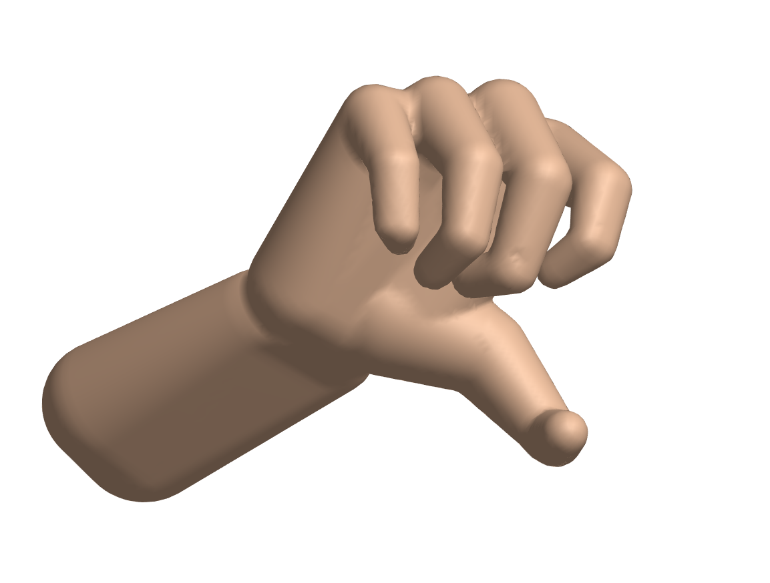
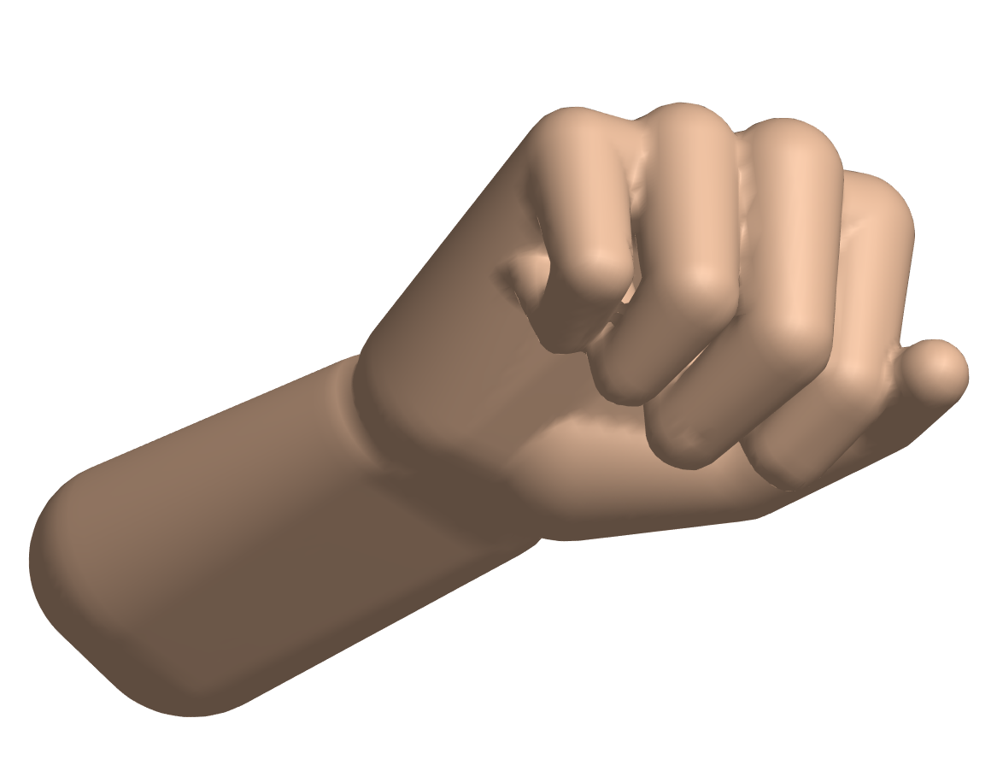
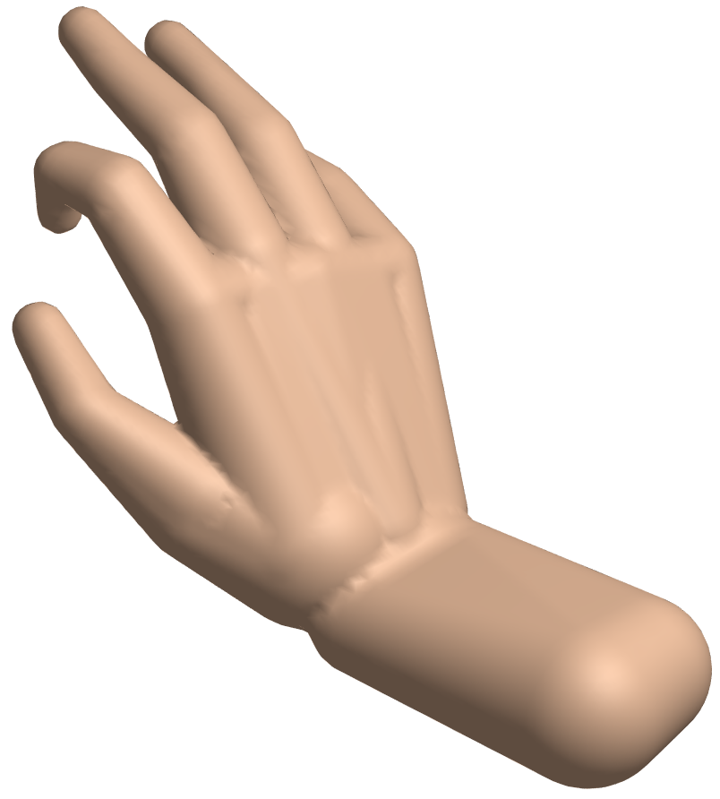
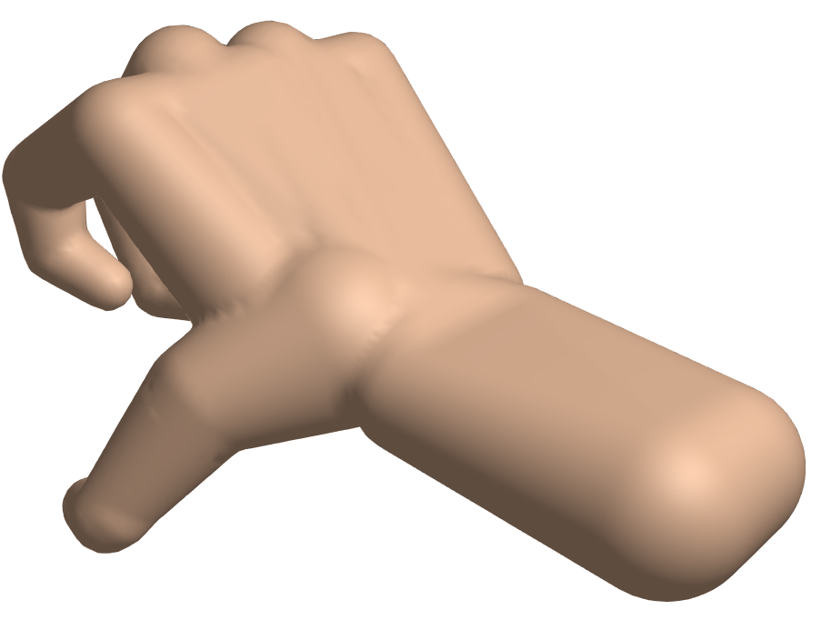
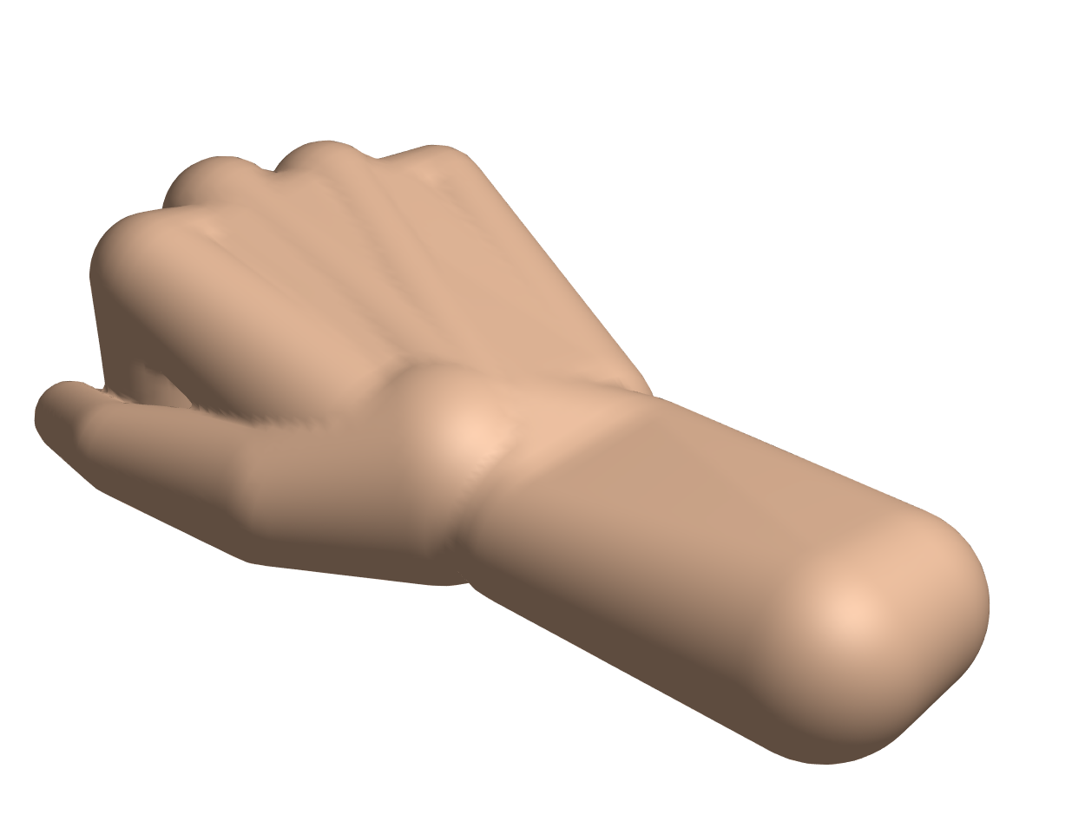

Slide 22
Tracking

Slide 23
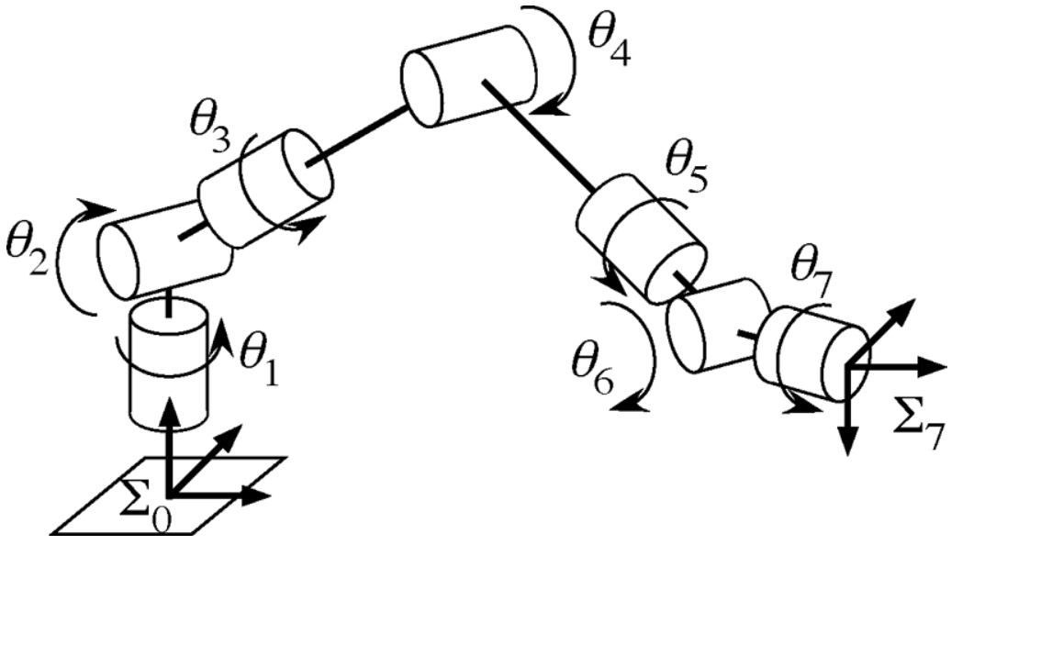
Position-based IK

Slide 24
Skinning

Slide 25
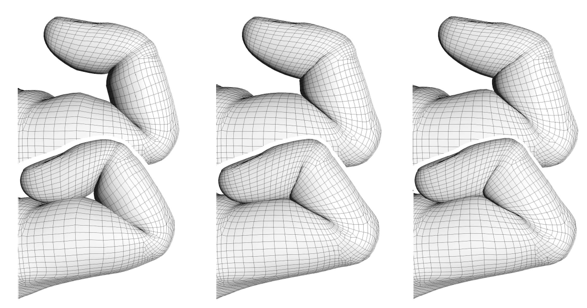
Implicit Skinning

Slide 26
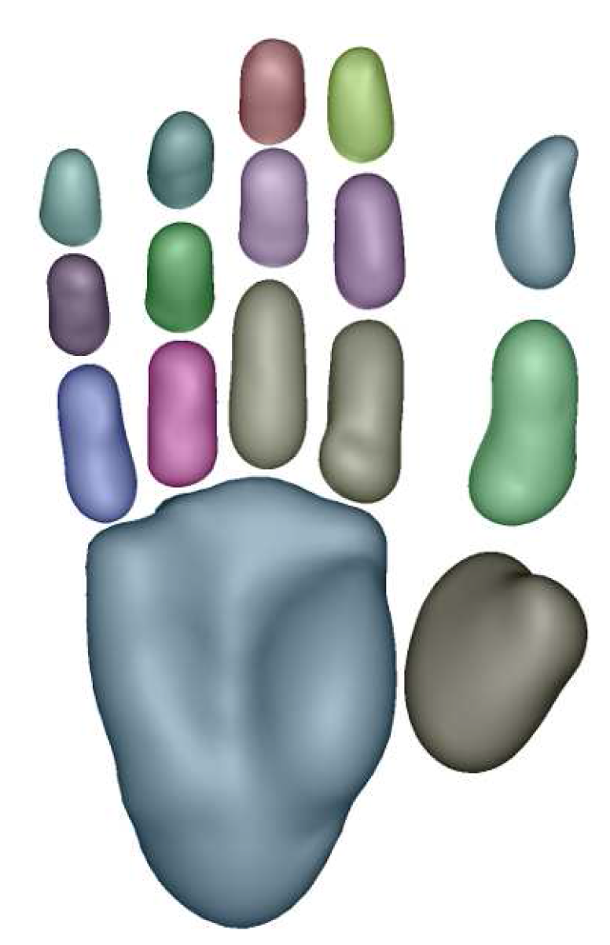
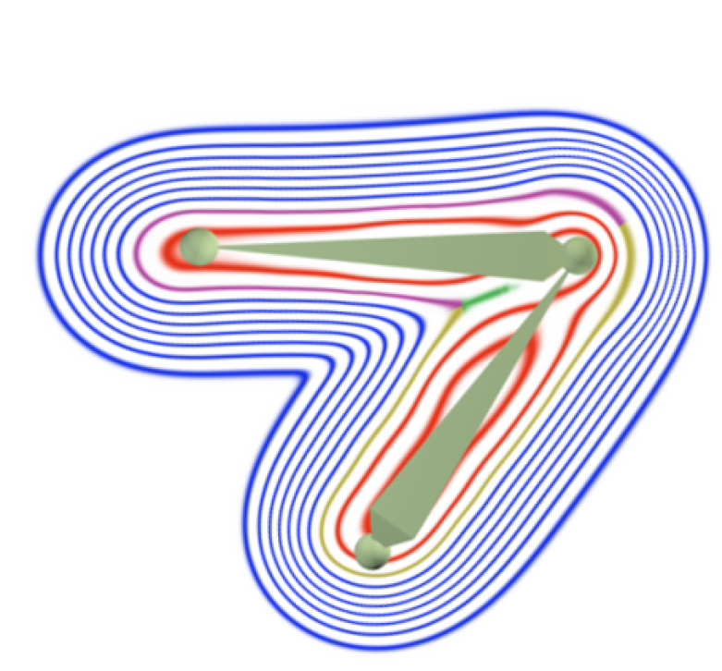
Implicit Skinning

